Slide 1
Before Bell:
You will have 10 min to finish the ad project!

Slide 2
Warm Up: Vocab Unit 2 Choosing Right Word

Slide 3
Work Cited Issues I noted:
Sources need to be in alphabetical order based on the first word in the citation.
You need to have a .5 Hanging indent on the second line of citation
Double spaced, Times New Roman, 12 point font…...this will never change!
Display your URL to help you find your source again!
Do you keep a source on the work cited if you do not use it on your paper? What if I cite a new source I found today or yesterday...where will that go?

Slide 4
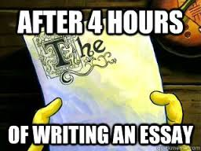
Outlines
The point is to be have the majority of the essay organized and written. Writing the draft should be a lot of copying and pasting!

It needs to have a hook, a thesis, topic sentences, quotes/paraphrases, and citations!


Slide 5
Basically What I am Looking For…
1. Intro → policy claim/thesis: Intro should answer three basic questions.
Background information. Expository research that proves a problem exists and/or gives the history of the problem.
A minimum of three main points. These are the most important parts of your paper. They prove the position you proposed in the thesis. They are structured using Toulmin.
Acknowledgement of counterclaim and refutation.
Conclusion: Not the paragraph, but the points you want to return to here.

Slide 6
Things to avoid
The use of I, WE, ME, YOU, US -------> these words mean it’s just your opinion not facts!
Overgeneralization----> True or false? “All people taken in police custody get hurt.” “All people who eat GMO’s get cancer.”
Either/Or----> True or false? “People may feel that music is a fun thing, but sometimes it is and it isn't. They either like it to be censored or not.”
Not capitalizing proper nouns: mrs. rhodes is a cool teacher--> that makes them feel unimportant!!! :(

Slide 7
Hook: How will you draw the reader in?
Shocking statistic: “Ninety percent of animals in shelters are euthanized each year.” ***Needs a citation!
Short Story: Michael Oher, a football player unlike any other, was able to show the amazing impact athletics can have and its ability to help students in need.
Thought Provoking Idea: Many have heard the phrase “it’s a small world,” but the veracity of this statement is lost to many. With the ever increasing number of people, the world has literally become smaller, leaving space as the next logical habitat for humans.
If you can’t think of one, write the outline then circle back to this...usually by then, you have some ideas floating around!

Slide 8
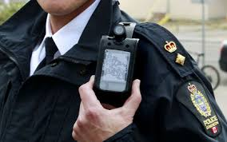
How do I make a thesis?????
Thesis= Claim on the topic + Solution (call to action)
My topic/claim: Cases of police brutality have increased and causes too many deaths.
My solution: Body cameras can help prevent excessive police brutality.
Thesis: Police brutality and extreme force have become more apparent in the United States due to recent arrests and death of unarmed civilians in police custody; to prevent the use of excessive force by officers, wearing body cameras while on duty should be mandated.

Slide 9
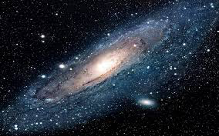
Again Thesis=Claim+Solution
Topic/claim: Space exploration needs to continue to search for potential resources and alternate planetary life.
Solution: Funding NASA is necessary to continue research on these cases.
Thesis: The government must continue
to fund NASA’s space exploration
because Earth’s resources and
capabilities are not infinite and may
one day be completely exhausted.

Slide 10
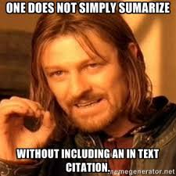
Citations
“Detail”: Exact quotes from a source, paraphrase from a source will need to have an in-text citation. Example: (Rhodes).
Turned in a Works Cited page? I have highlighted what goes in your in-text citation :)
This should match to the work cited page.
For each citation, you must have a work cited credit!
Author’s last Name Article Name Publisher
(Rhodes). (“English 3 Rocks”). (CNN).
NEVER FULL WEBSITE!

Slide 11
Elaboration!
Elaboration is your chance to tell the reader what your source proves, shows, or how it relates to your thesis!
Detail: “Mrs. Rhodes’ students give higher ratings to English class than other English III students, reporting having 5-10% more fun each day” (“The Truth”).
Elaboration: Research from “The Truth about English III” proves that English III students who have Mrs. Rhodes are more likely to have a positive experience. This further indicates that having English every day will increase one’s level of happiness.

Slide 12
Now you try!
Please log on to Google Chrome books!
In Google Chrome, go to classroom.google.com
Class Code: 6nere9
3. Click into the Class, and click on the assignment Outline Template!

Slide 13
Reminders!
Outlines MUST BE TYPED are due PRINTED on Monday (I will not print this for you…. like at all!!!)
Unit Quiz WEDNESDAY!

Slide 14
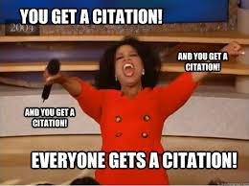
Lets practice with citations!
Works Cited Page: What is wrong here?
Melany Mcafee. "Chimps in Need after U.S. Organization Withdraws Care - CNN.com." CNN. Cable News Network, 11 Sept. 2015. Web. 13 Sept. 2015. <http://www.cnn.com/2015/09/11/living/chimpanzee-liberia-new-york-blood-center-feat/index.html>.
In Paper: How do I cite this correctly?
“This chimp needs help says Melany.”
Mcafee,Melany. "Chimps in Need after U.S. Organization Withdraws Care."
CNN. Cable News Network, 11 Sept. 2015. Web. 13 Sept. 2015.
“This chimp needs help says Melany” (Mcafee).

Slide 15
Outlines Topic Sentences
The topic sentence will set the tone for the rest of that paragraph!
Topic Sentence: Body cameras provide an unbiased look at police actions and arrest.
Detail: “85% of body camera cases are easily prosecuted are dismissed due to the unquestioning reliability of the cameras, making everyone more aware of their actions and words” (Nickell).
Elaboration: This proves that due to police using body cameras, citizens and police officers are held more accountable in the situation.

Slide 16
Lets practice topic sentences! Write a topic sentence for each.
Topic Sentence: ???????
Detail: “Many laboratories utilize animals for testing on products and medicines meant for consumer consumption and use” (Nickell 1).
Elaboration:This means that many animals are subjected to products that are not safe for humans, many times experiencing bodily harm even death for a product like anti-wrinkle cream.
Topic Sentence: ??????
Detail: “Most college athletes reported spending over 8 hours a day to training and practice for their respected sport while still working to maintain course loads, and work hours to support their financial needs” (Nickell).
Elaboration: Many college athletes must work to maintain a GPA and work extracurricular positions to cover cost outside their scholarship funds, while working to provide their time, body, and mind to their sports which is more stressful than the normal college students schedule.

Slide 17
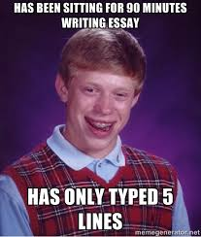
Now you try!
Please log on to Google Chrome books!
In Google Chrome Drive you should see your outline from yesterday! If not log back into classroom!
Outlines are due Monday!!

Slide 18
Reminders!
PRINTED outlines are due Monday(I really will not print this for you…. like at all!!!)
Include an updated Works Cited page that has only what you have used on your outline.
You need The Scarlet Letter books for Monday.
Vocab 2 NEXT WEEK!

