Slide 1
Before Bell:
You have a vocab quiz today!

Slide 2
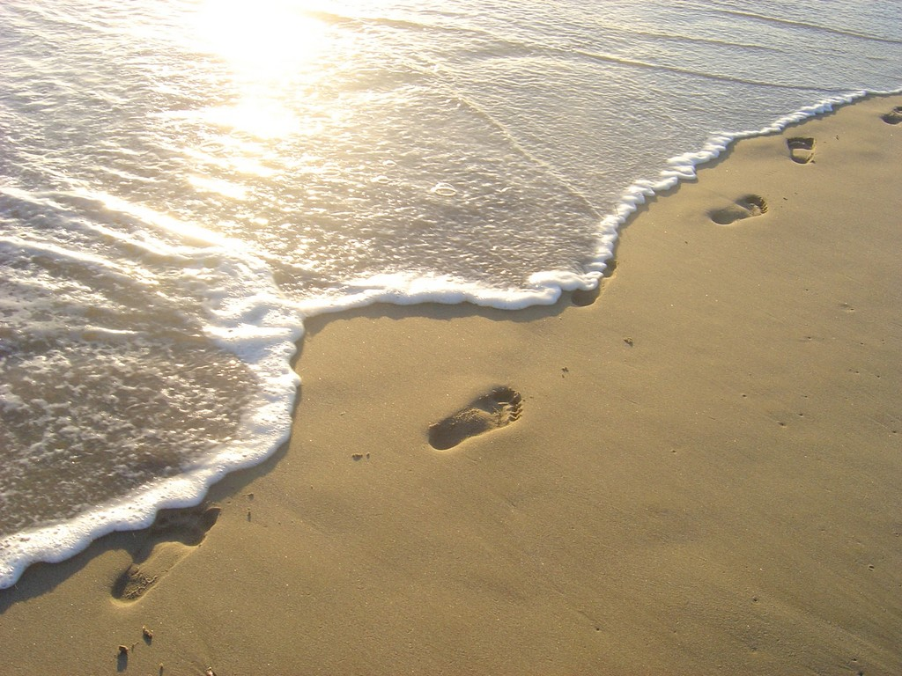
After the quiz…
Finish “Tide Rises, Tide Falls” (started yesterday!)
Work on first three pages OR read TSL

Slide 3
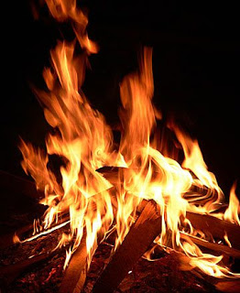
Fireside Poet Quiz
You have 5 minutes to review for the quiz!

Slide 4
After Quiz
Evaluate your outline using the feedback given and the structure below. Which paragraphs do you need to revise and further develop?
Introduction: Statement of the Problem and the Thesis Sentence
Body: Paragraphs 1 and 2: History of the Problem (Include, perhaps, past attempts at solutions. Work in sources to add backing)
Body: Paragraphs 3 and 4: Extent of the Problem (Who is affected? How bad is it? Work in sources to add backing.)
Body: Paragraphs 5 and 6: Explore Counterargument and Refutation (Work in sources to add backing.)
Body: Paragraphs 7 and 8: Call to action/Solution to issue (not necessarily your own. More sources.)
Conclusion: Summarize your findings

Slide 5
Outline Issues
Since this is research…NEVER EVER use I, We, You, Me, etc.
Not citing a source is 100% plagiarism!
Need a balance between direct quotes and paraphrases. DON’T RELY ON ONE ONLY!
Numbers: any number under 100 should be spelled out so instead of “2%” you would write “two percent”.
We are an English class so any proper noun, like names, deserve capital letters; they are important!
Paper main points did not follow logical sense of argument steps (claim, backing, counter argument, refute, call to action)
In-text citations: Author’s last name or correctly punctuated title. Examples: (Wallace). or (“How Music”).
The period should go AFTER THE CITATION!
You don’t need 15 sources anymore! Stick to around 8.
Diversify within body paragraphs.

Slide 6
Lets review together:
Academic voice: a formal, elevated style.
Everyone should recycle because it is really important.
Recycling is intrinsic to the elimination of pollution because it reuses materials that are non-biodegradable and decreases greenhouse emissions.
What are the differences between these two? Which is better and WHY?

Slide 7
Lets review together:
Argumentative writing is NOT OPINIONATED:
Can you believe that some people think that recycling doesn’t make a difference? These people are putting our future in danger since they don’t want to save the planet.
Some opponents claim that material sent to recycling facilities does not actually get recycled, so there is little incentive to recycle.
What are the differences between these two? Which is better and WHY?

Slide 8
Lets fix these issues together:
Counterargument: The OPPOSITE of your stance.
Thesis: Schools should have four day weeks.
Counterargument: Schools should not have four day weeks.
Thesis: The US should create eligibility requirements for gun ownership.
Counterargument:
Thesis:
Counter-argument: The government should fund free, public college education for all students.

Slide 9
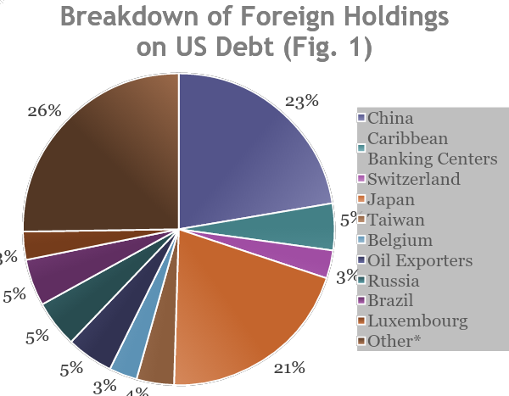
What your graphic should look like!
Source: Labonte, Marc and Justin Murray. Foreign Holdings of Federal Debt. Rep. N.p.: Congressional Research Service, 2012. Print.

Slide 10
Rough Draft Day: How to make a graphic!
YOU HAVE TO MAKE IT…this is not a copy and paste job!
Your sources should give you the data and numbers to be able to create a visual
Since you are using a source to get data/numbers…YOU HAVE TO CITE IT internally and one on your works cited page!
Create a Graph
Online Chart Tool

Slide 11
Where in a paper could you add a graphic?
The chart should not prove you wrong!
Support body paragraph or refutation
What will impact your audience most?
Statistics, money, percentages, surveys, showing a time lapse
How do I integrate the graph into my paper?
Paragraph that discusses information first, then graph to support ideas
The paragraph reports how many people recycle and how it has grown. Insert graph and citation below it.

Slide 12
Today…
Plan and/or create a graphic for your paper.
You may start to type and save the first three pages of your paper to turn in Monday; utilize outlines to start paragraphs and ideas!
Due Monday: 3 pages of your rough draft…this should also include a current work cited page…so 4 PAGES total!
This will be your last chance to get feedback directly from me before your final paper…do not slack off!

Slide 13
Before Bell:
Please get out your outlines from
Tuesday

Slide 14
Warm Up: Which is correct? Right or left?
I really enjoyed “I Hear America Singing.”
Pudd’nhead Wilson is the book we are currently reading.
We’ve read The Scarlet Letter already this year.
I think “The Avengers” is a good movie.
I really enjoyed I Hear America Singing.
“Pudd’nhead Wilson” is the book we are currently reading.
We’ve read “The Scarlet Letter” already this year.
I think The Avengers is a good movie.

Slide 15
To italicize or not?
Book titles Pudd’nhead Wilson
Movie titles Hunger Games
Magazine names People Magazine
Newspaper names Charlotte Observer
Albums (Pink Floyd’s 1973 album Dark Side of the Moon)
TV shows (The Simpsons)
Video games (Call of Duty: Black Ops)
The names of boats (who knew? HMS Titanic)
Named legal cases (Roe vs. Wade)

Slide 16
Don’t italicize
Almost all of these get “quotation marks” around them
Chapters in a book
Individual poems (William Cullen Bryant’s “Thanatopsis”)
TV episodes
Articles in a magazine or newspaper
Songs on an album (“Money” from Dark Side of the Moon)

Slide 17
Today…
Utilize your time identify and create a graphic for your paper.
You may start to type and save the first three pages of your paper to turn in Monday utilize outlines to start paragraphs and ideas!
Due Monday 3 pages of your rough draft…this should also include a current work cited page…so 4 PAGES total!
This will be your last chance on feedback directly from me before your final paper…do not slack off!

