Slide 1
Integrating Quotes
The ins and outs

Slide 2
Why have quotes?
To prove your points are right
To demonstrate how you arrived at your idea
To connect the idea to your specific novel or topic

Slide 3
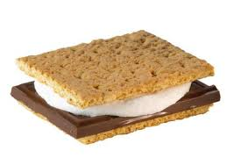
How to use Quotations
All quotations need an introduction followed by analysis.

Slide 4
What not to do
You want your quotes to be integrated into your writing. They should NOT be:
- dropped in
- disconnected to paragraph - irrelevant to paragraph

Slide 5
Use some variety…
“Says” is not the only signal word.
“This quote…” is a very overused introduction.
Most adroit quote integration appears to be a natural part of the original sentence you write.

Slide 6
Your turn…
Come up with the missing piece (introduction or conclusion) for each quote.
Orual’s perception of “a love like that can grow to be nine-tenths hatred and still call itself love” (Lewis 266) demonstrates_____________________ ____________________________________________________________.
___________________________ “You mean- I’ll believe you mean- nothing but good” (Lewis 160) provides a brief moment in which Psyche allows for the possibility of Orual’s conscious choice to commit malicious actions.
_____________________________ “She’ll be a stronger woman than ever I was. She’ll have that as well as her beauty” (Lewis 103) ___________________________.

