Slide 1

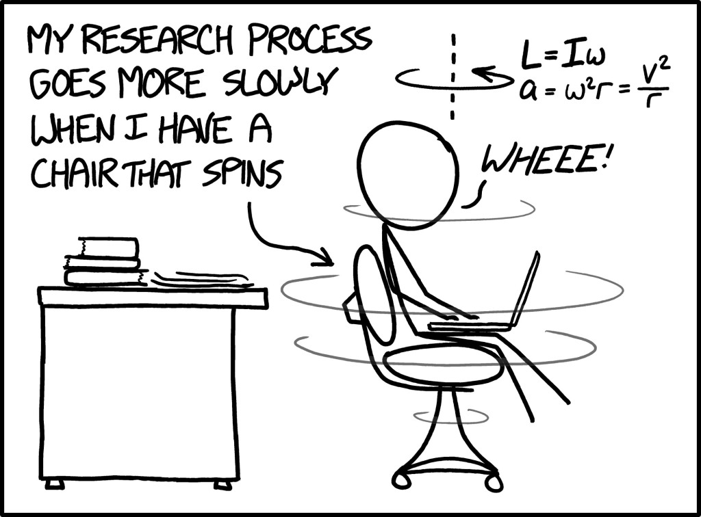

Grad Project- Fun TIMES!
The need-to-know
details

Slide 2
Grad Project
This paper should be seen as an extension and refinement of the research paper skills you learned in English II, as well as interests from other subjects.
While you will receive support in class, you are expected to remember and use those skills and strategies this year.
The presentation, during Senior year, will allow you to present all that you have learned and educate an audience about your topic. It is professional in nature.

Slide 3
What is the Graduation Project?
The Graduation Project is an opportunity to pursue the resolution of a question about which you have genuine concern or interest.
The question may grow out of interest that you have had for some time or one that has arisen recently through course work or personal experience.
As you identify and pursue resolution of your question, you will learn a great deal about your topic and yourself.

Slide 4
The Graduation Project - Overview
You will learn to:
  Create goals, recognize persuasive arguments used by others, recognize source bias, and learn to create your own arguments.
You will read:
  books, magazines articles and internet publications about your topics.
You will practice writing and researching strategies in class.
  Your paper will be approximately 6-8 pages.
You will discuss your topic with numerous people.
You will enlighten an audience on your topic through a verbal presentation.

Slide 5
Graduation Project- The Facts
6-8 page essay
- At least 5 sources (with a primary source)
- Graphic
- MLA format
- Works Cited
2. A topic that allows for a community service opportunity MINIMUM 15 hours (can extend through Senior year)

Slide 6
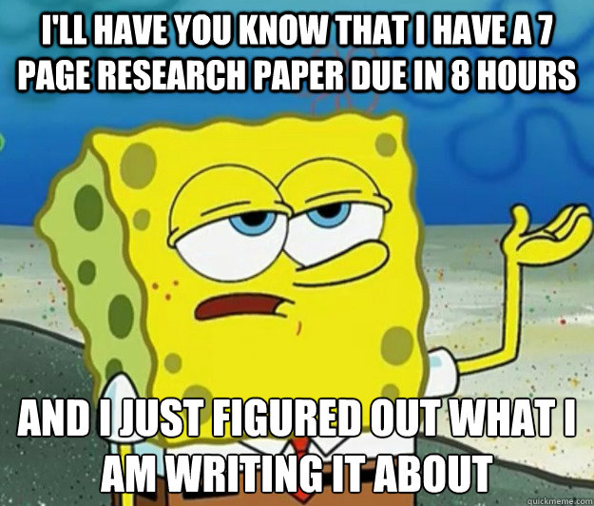

Topic
YOU pick the topic . . . So make it interesting!
  You’ll be stuck with this topic for the next two years.
Don’t choose something that you will be uncomfortable talking about or that you are already an expert on.
  Suggestion: Choose something that you may be able to find a solution for. “Begin with the end in mind”. This means that you should pick a topic that is not only interesting for the paper part but will also be practical/ realistic next year.

Slide 7
Topic Denials
NOTE: I reserve the right to refuse any research topic. Some topics, no matter how interesting, simply do not lend themselves to this project.
  Inability to sustain a 6-8 page paper
  Inability to create an objective policy claim
  Controversial for the sake of controversy
  Inability to complete volunteering associated with topic

Slide 8
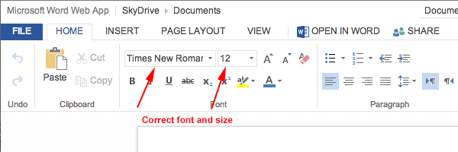
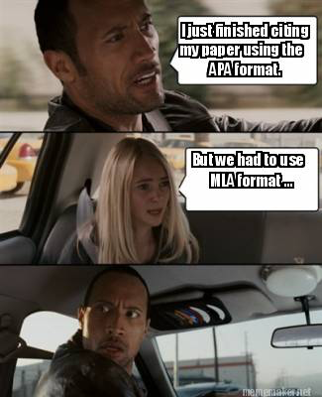
MLA Format
Times New Roman, 12 pt. font
Heading
Page #
In-Text Citations
In this class, we’ll be using MLA guidelines to format our papers and essays.
Where can you go to review/ learn more about MLA?
  https://owl.english.purdue.edu/owl/

Slide 9

Essay
ARGUMENTATION/Persuasive: Develop an argument about the topic, and use your research (and information you find as the project evolves) to support that belief and convince others of the validity of your belief.

Slide 10
Steps for the Essay
Collecting Data
  We will research days during the semester to find research that best supports and counters your arguments.
There will be workshops throughout the semester to help you along the way…
You will learn to carefully document all research
information and review MLA guidelines
for citations.

Slide 11


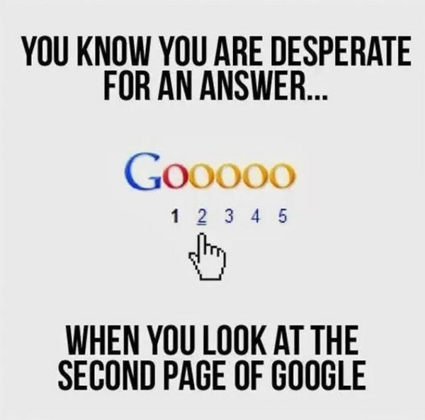
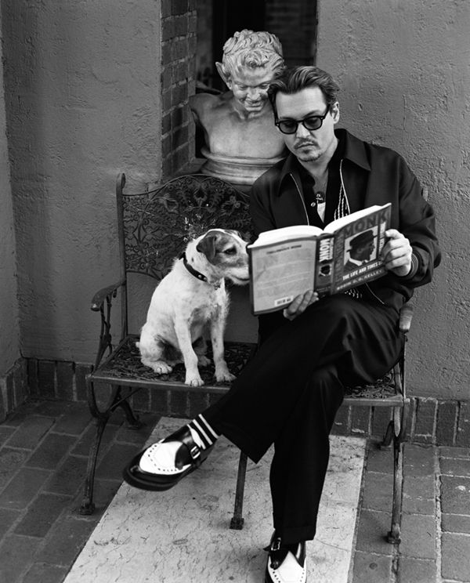
RESEARCH!
Research should take a variety of forms:
  primary and secondary sources
  journals
  books
  newspapers
  non-print sources
  (video, graphics, tables, and charts)
Simply GOOGLING a topic is not RESEARCHING a topic
Plan on accessing a minimum of 15 resources. Do not rely solely on online sources.
Johnny Depp and his dog doing research

Slide 12


Visual aid
DO
Don’t
Essay MUST have one.
MUST be a student generated visual aid.
The visual must be research based and that research must be cited!! ☺
Possible options: diagrams, charts, graphs, maps, or artistic renderings (such as a drawing, sketch, floor plan).
Copy and paste
No Google image search
Just added to end of essay with no integration
Make smaller than ¼ of a page or larger than ½ a page

Slide 13
Graduation Project Presentation (Senior year)
Complete a 6-10 minute speech during your senior year.
  Present the research compiled this year
  Discuss the real-life connections to your topic gained through the community service project
  Professional in nature

Slide 14
Graduation Project: Service Learning Opportunity
The expectation is that you will complete some kind of community service that ties into your topic.
Must get approval for what you plan on doing
You must document this experience: journal, photos, signatures, etc.
You may start your community service whenever you like; just be sure that you are documenting your experiences.

Slide 15

Important Due Dates
9.2: topic approval form due
9.7: working bibliography with at least ten sources
9.15: outline
9.23: first three pages with turnitin.com submission
9.30: final rough draft with turnitin.com submission
10.7: final paper due with turnitin.com submission
I will have the important dates posted in class and on my Weebly. PLEASE KEEP TRACK AS WELL!

Slide 16
Portfolio
If you turn all components of your paper in on time, then you will receive a 50-point test grade at the end of the semester.
The components are:
  Topic approval form
  Working bibliography
  Note cards
  Outline
  First three pages (initial rough draft)
  Final rough draft
  FINAL PAPER
  This checklist/Portfolio
If you lose any element of the portfolio (the original document that is peer edited or written on by me), you will lose those points.
Late work will be docked by half (this includes failure to include a turnitin.com submission).

Slide 17
A few notes
If you bring your paper to me during a tutoring session, I will help you, but I won’t necessarily fix your paper.
  While I will edit some portions of your essay/submitted items, I DO NOT HAVE THE ABILITY to read everyone’s full, final draft in a timely manner.
Please pay attention in class! If there is something you don’t understand, ASK ME. I can’t help you if you don’t tell me where you are struggling.
Rough drafts will be spot checked for MLA and format.
This paper will make up 20% of your Q2 grade.

