Slide 1
MLA Format
…and other really, really important stuff.

Slide 2
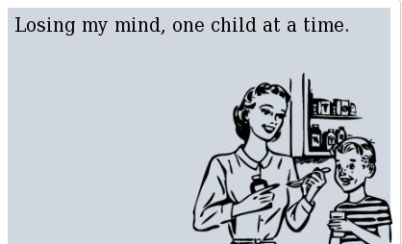
Things to do (and not do) to keep Ms. Siciliano from losing her mind:
Do this:
Times New Roman font
FOR EVERYTHING
12-point font
FOR EVERYTHING
One inch margins all the way around
Delete the extra space from between paragraphs
Heading (on the left side) on first page only
Your name
Class/Block/Teacher
Due date spelled out
Include a Works Cited page, even if you just have one source
Last name and page number in upper right corner of all pages
Double space everything, including heading
Book titles are italicized; poem/short story/article titles are in “quotes”

Slide 3
Don’t do this:
No contractions
No personal pronouns (I, you, me, we, us, our)
No “I believe,” “In my opinion,” “This is why,” “This quote shows,” “In this paper,” etc.
There’s more.

Slide 4
Citations and Works Cited
Anything that isn’t your own personal information needs to be cited:
If you include a quote
If you include a paraphrase
Citation goes in parentheses after the quote
Period doesn’t end the quote; it goes AFTER the citation (even if your quote is a complete sentence)
Works Cited goes at the very end, on its own page
Should be in alphabetical order by first word
Not an issue with only one source.
Check out easybib.com for help on making citations for other sources
An example…

Slide 5
When in doubt…
Go to the Essay Writing Assistance tab on my Wiki. I have EVERYTHING you will need to know about how to write a paper.

