Slide 1
Quote Integration
Reminders and Practice

Slide 2
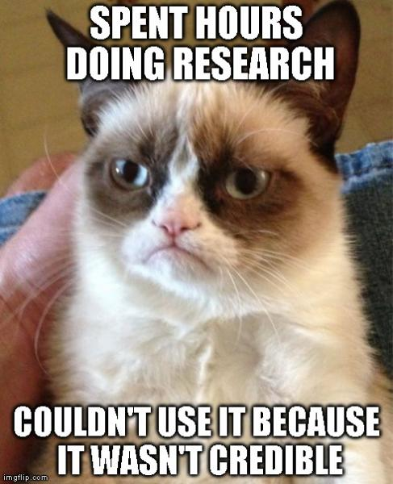
Purpose Structure
Introduce quote: provides relevant information, context, or transition
Research: a direct quote (with “”) or a paraphrase; has an in-text citation
Elaboration/Analysis: shows how quote proves the thesis/point of paragraph
Support your thesis
Prove that your claim is valid
Establish credibility to the argument

Slide 3
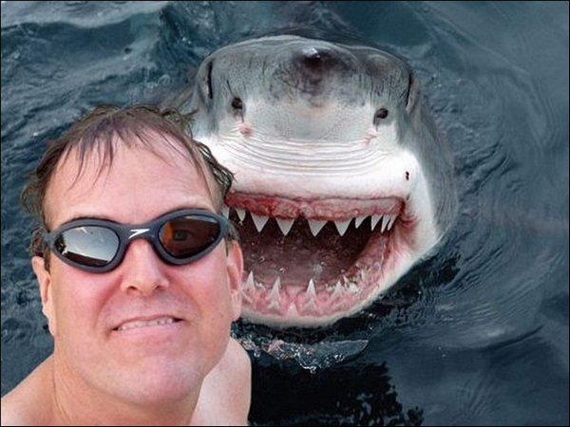
Ways to Integrate Research
http://www.huffingtonpost.com/entry/selfie-deaths-shark-attacks_5602c0c5e4b0fde8b0d09cbe
Direct Transition:
Humanity’s preoccupation with itself has grown to new levels, as is reported by Huffington Post: “Selfie-related accidents have killed more people worldwide this year than shark attacks have, and they’ve killed at least twice as many if you include only “unprovoked,” confirmed shark attack” (Hanson). People’s desire to take their own picture causes them to take risks that would have been unusual before the widespread use of technology.
Integration into Sentence:
People do not always consider the danger that they put themselves in when attempting to gain a perfect picture. Although “...11 people ha[ve] died during selfie accidents, while eight people worldwide were killed in shark attacks” (Hanson)may not seem like a high statistic, it does show that what people consider a hazard must be reconceptualized. Many would label sharks as far more dangerous than a phone, but the ever present desire to have a great selfie can cause harm in a way never considered.

Slide 4
Your Turn: Take the quotes and add the missing piece
http://www.huffingtonpost.com/entry/babies-ipad-screens_56019e09e4b00310edf8ce12
The increased use of technology in everyday life has posed a problem for parents. “The American Academy of Pediatrics loosely recommends that screen time be avoided for children under age 2, a time when the brain is rapidly developing...at least 38 percent of kids under 2 have used a mobile device” (Gregoire). _____________________________________________________________________________________
_____________________________________________________________“University of London cognitive scientist Dr. Annette Karmiloff-Smith argued in her own Nursery World op-ed that tablets are healthy and educational for babies. Karmiloff-Smith's research recently found that tablets helped toddlers' number recognition” (Gregoire). The lack of definitive proof about technology usage by young children only shows that more research needs to be completed in order to truly grasps the ramifications of technology.

