Slide 1
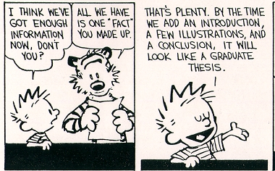
A Research Thesis

Slide 2
Reminders
The introduction should lead up to the thesis.
Thesis should be a simple, declarative statement.
The thesis should be the main idea of your paper.

Slide 3
EXAMPLES
POSSIBLE THESIS:
The band fun., categorized as pop, has been influenced by music from a drastically different genre: Kanye West’s rap.
ANOTHER POSSIBLE THESIS:
The sanitization of cinematic fight scenes has led to a desensitized American populace.

Slide 4
Both example thesis statements are claims that can be backed up with research.

Slide 5
Both provide an “angle” to evaluate with research.
Each presents something that could be unexpected.
An outline could be logically constructed for these thesis statements.

