Slide 1
Before Bell:
Grad Paper rough drafts due tomorrow.
PLEASE GRAB CHROME BOOK

Slide 2
Grab a Computer: Turnitin.com
Please register for an account (try using your school ID email).
Class ID: 2nd: 14551387
3rd: 14551430
4th: 14551443
Password: english

Slide 3
How to Use Turnitin.com
Go to turnitin.com
Create an account using your personal email.
Use the class ID, on the previous slide, that matches your class.
The password for the class is english.
Answer the rest of the profile questions and finish making your account.
On your homepage, click on the class.
Next click Submit for First Three Pages assignment.
At the top, click on “Copy & Paste” and change to “Single File Upload”
Provide information and upload your paper. Click blue button at bottom.
Click “return to homepage” (or something like that phrasing) to finish submission.

Slide 4
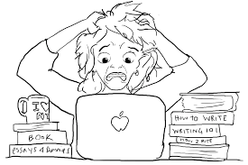
Rough Drafts
Rough drafts 6-8 pages are due tomorrow in class! You must turn it in on turnitin.com as well!
Graph: Onlinecharttool.com
Work Cited Page: www.easybib.com
In Text Citations (Author's last name). or (“Article Title”).

Slide 5
Closure:
Please turn in chrome books.
Please make sure yuo have your turnitin.com login information to submit papers to tonight!

